Slide 1
Snapshot

Slide 2
Exercises
Create Snapshot from Volume
Create Snapshot from Instance
Setup Snapshot in other region
Create/Launch AMI from Snapshot
Create Volume from Snapshot

Slide 3
Pre-requisites
Login to AWS account
Ubuntu instance is created & launched(e.g. N. Virginia)
Volume is created
Apache server is setup on Ubuntu instance
Security Group is opened for Apache server

Slide 4
Create Snapshot from Volume
Go to Snapshots section in left pane
Click Create Snapshot
Select resource type – Volume
Select Volume from list
Enter Description(Optional)
Click Create Snapshot

Slide 5
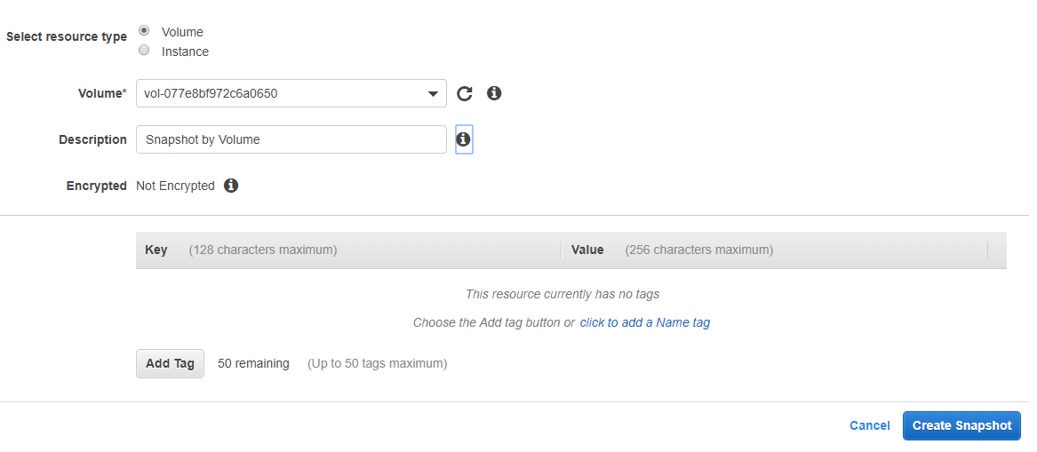
Create Snapshot from Volume

Slide 6
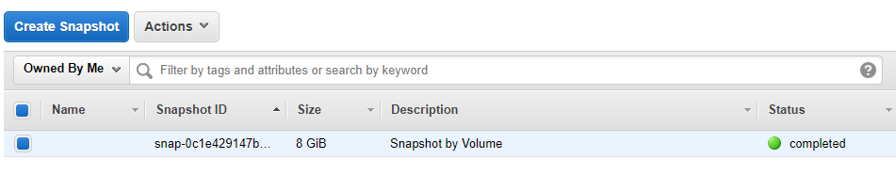
Create Snapshot from Volume
Close Created Snapshot section
Snapshot will be displayed in list

Slide 7
Create Snapshot from Instance
Go to Snapshots section in left pane
Click Create Snapshot
Select resource type – Instance
Select Instance ID from list
Enter Description(Optional)
Click Create Snapshot

Slide 8
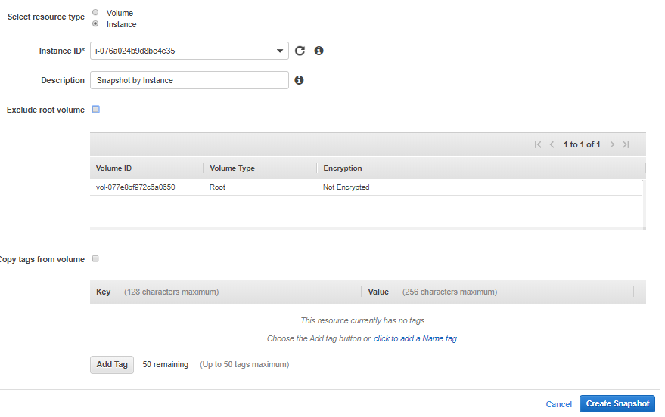
Create Snapshot from Instance

Slide 9
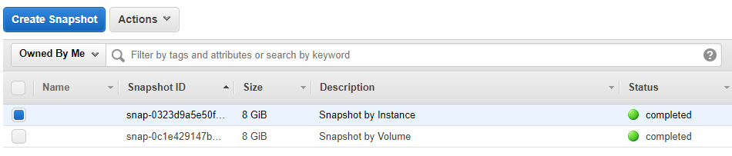
Create Snapshot from Instance
Close Created Snapshot section
Snapshot will be displayed in list

Slide 10
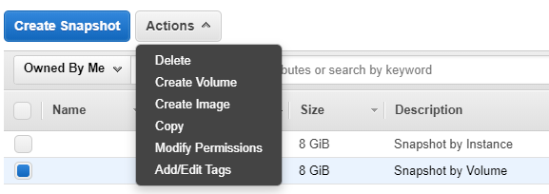
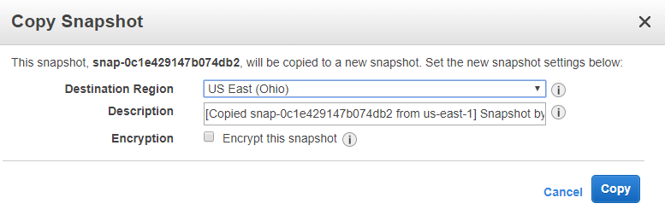
Copy Snapshot to other region
Go to Snapshots section in left pane
Select the Snapshot
Click Actions
Click Copy
Change region(e.g. Ohio)
Click Copy

Slide 11
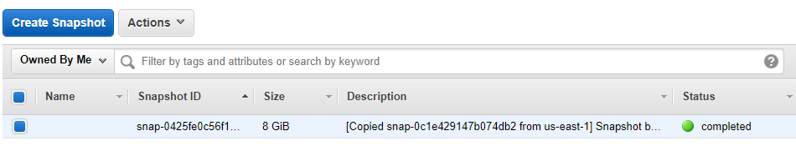
Copy Snapshot to other region
Close Copied Snapshot section
Go to other region(e.g. Ohio)
Go to Snapshots section
Snapshot will be displayed in list

Slide 12
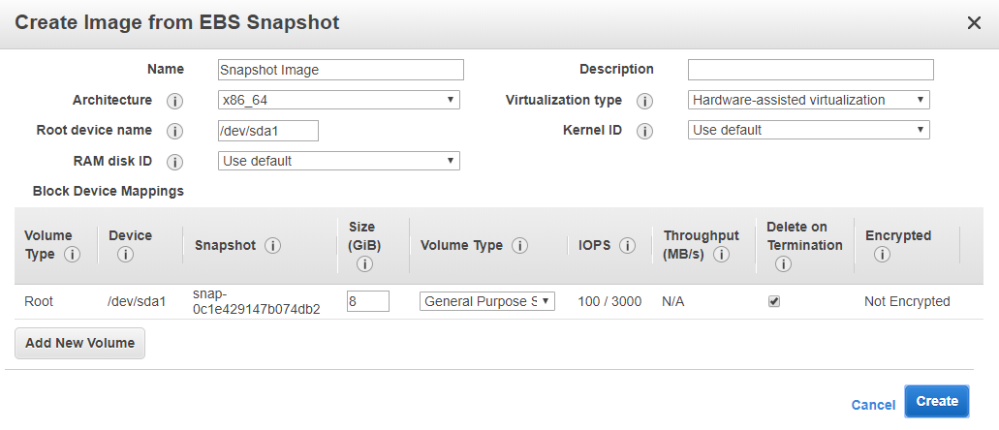
Create AMI from Snapshot
Go to Snapshots section in left pane(N. Virginia)
Select the Snapshot
Click Actions
Click Create Image
Enter Image name
Click Create

Slide 13
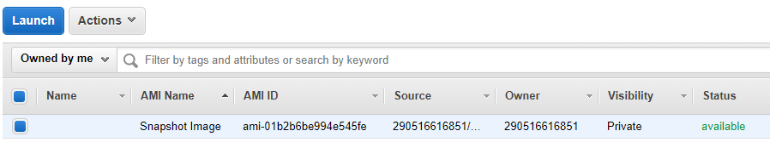
Create AMI from Snapshot
Close Created Image section
Go to AMIs section
Image will be displayed in list

Slide 14
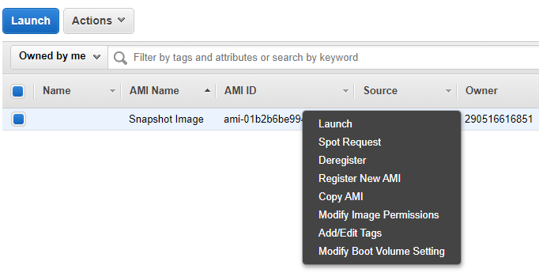
Launch AMI from Snapshot
Go to AMIs section
Select the Image
Click Actions
Click Launch
Follow the wizard to create new instance
When new instance is launched, run instance public ip address on browser to see apache web server ui

Slide 15
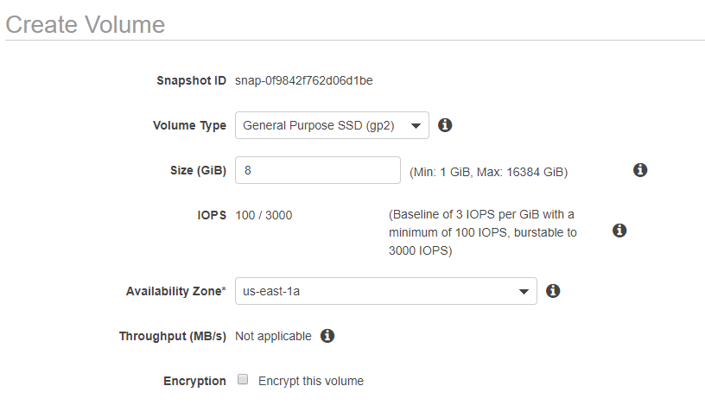
Create Volume from Snapshot
Go to Snapshots section in left pane(N. Virginia)
Select the Snapshot
Click Actions
Click Create Volume
Click Create Volume button
Close Created Volume window
Volume will be displayed in list

